Slide 1
Erin Farley
Senior Mastery

Slide 2
About me
Born on October 2nd, 1996 in Utica, New York
Moved to Myrtle Beach June of 2003
Have lived in the Carolina Forest area ever since
Play basketball and throw discus & shot-put in track & field

Slide 3
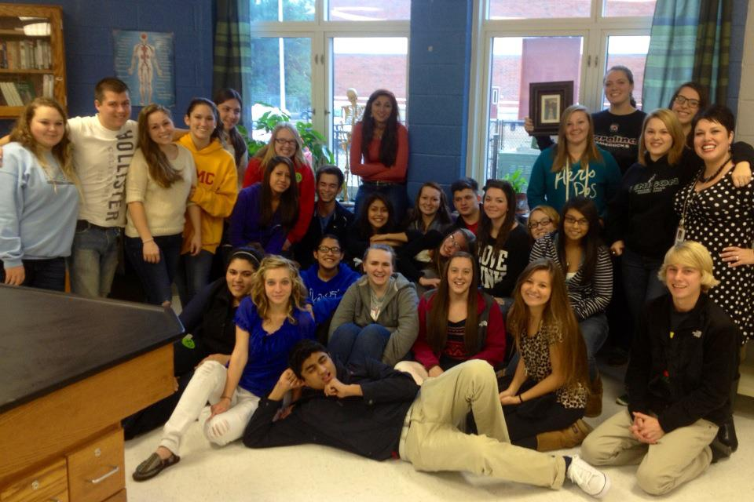
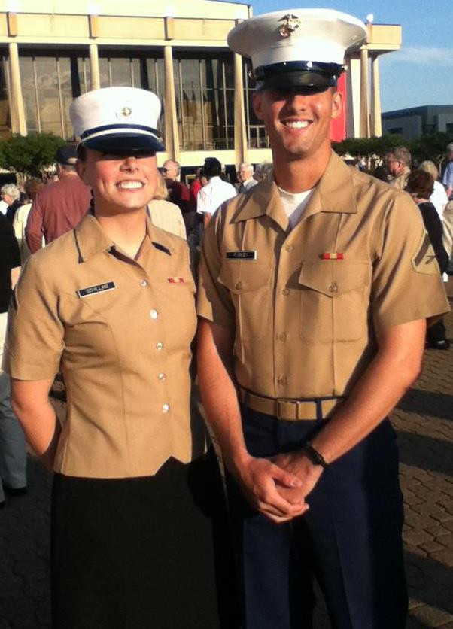
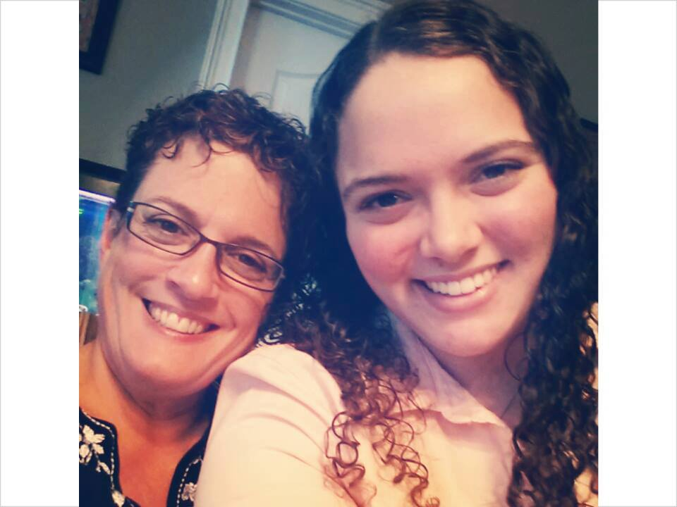
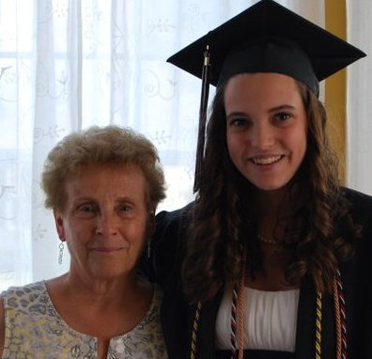
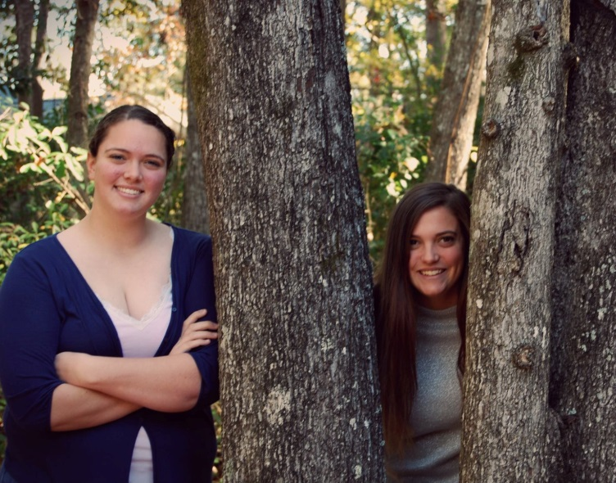
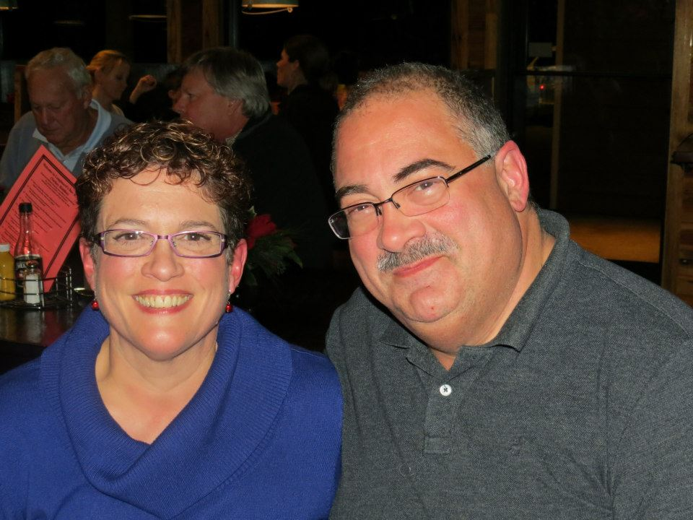
Important People

Slide 4
Future Plans
Attend the University of South Carolina; major in Cardiovascular Technology
Graduate from there and then proceed to medical school
Plan to do something with cardiology

Slide 5
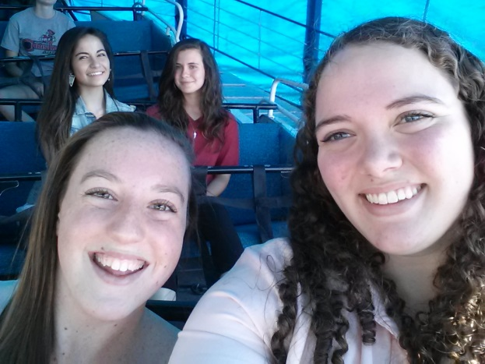
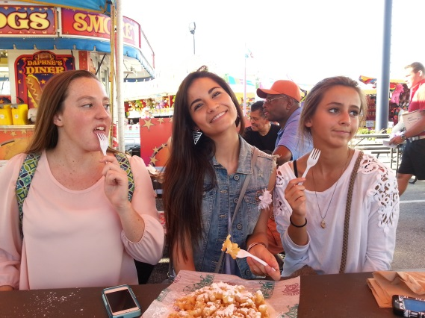
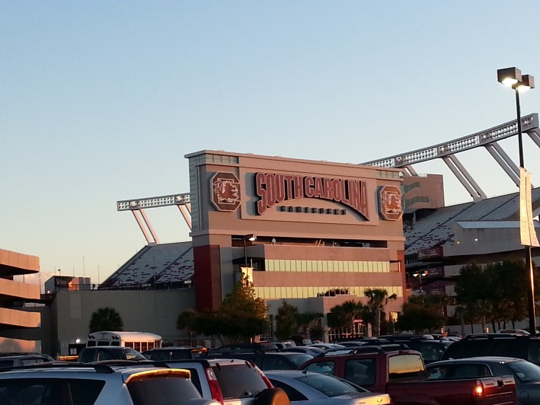
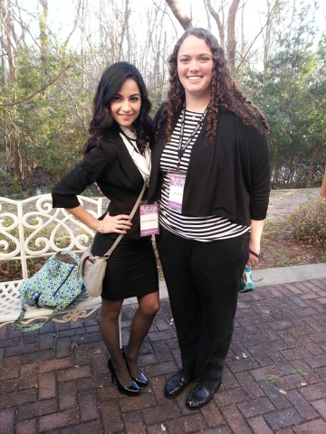
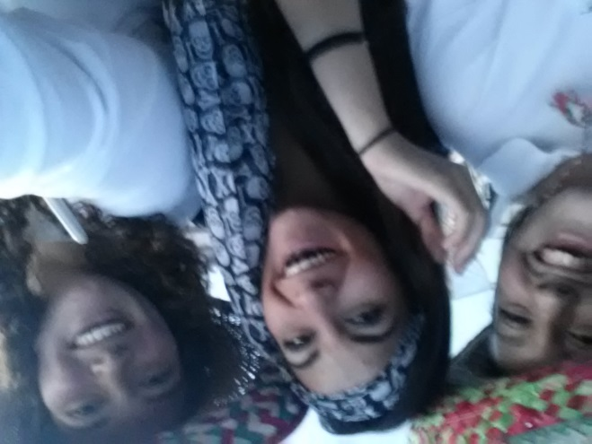
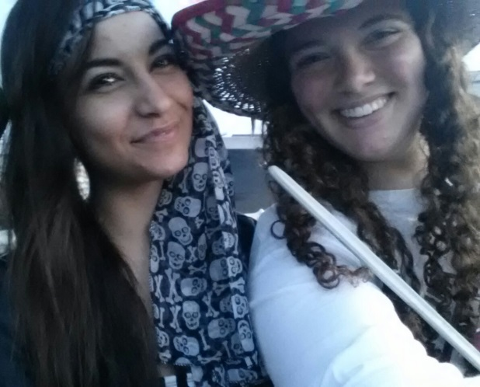
Experiences

Slide 6
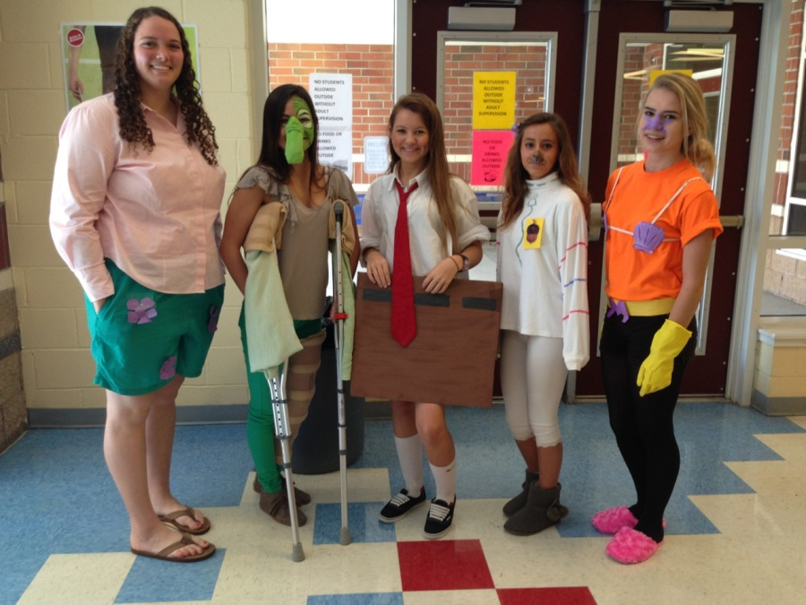
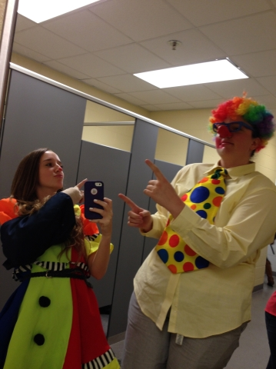
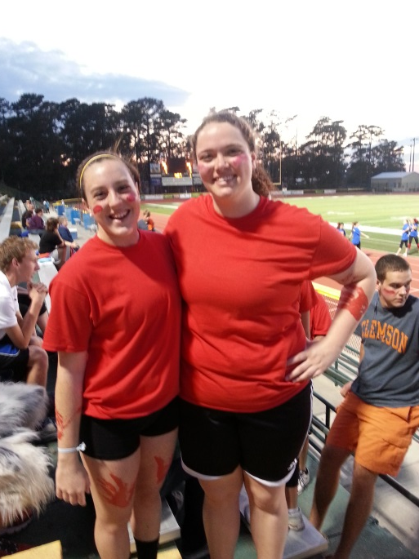
Experiences

Slide 7
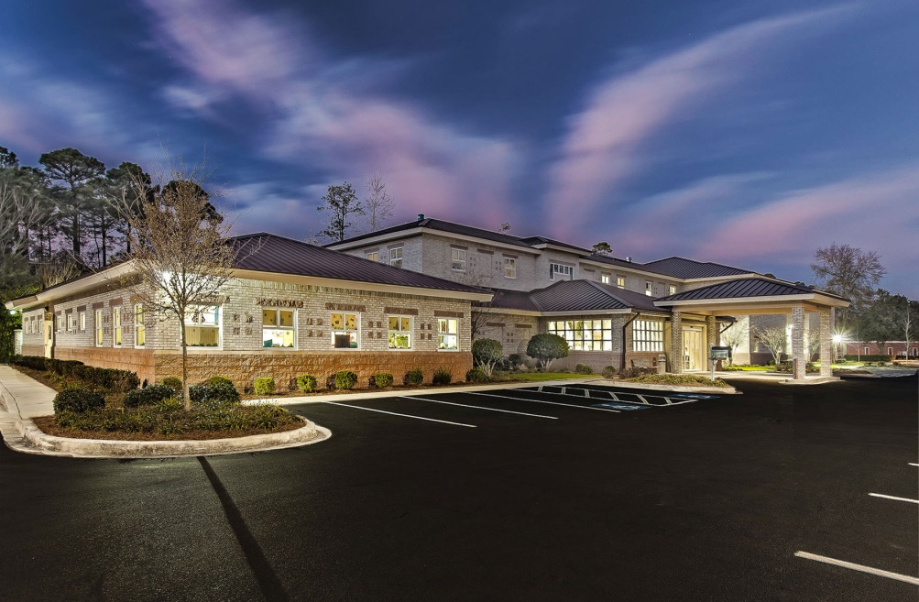
Experiences
http://www.bentonhenry.com/data/photos/779_1cancercenter_mb_hdr2f.jpg
http://childcarecenter.us/static/images/providers/5/156485/LOGOOfficial.jpg

Slide 8
Experiences
http://bloximages.newyork1.vip.townnews.com/myhorrynews.com/content/tncms/assets/v3/editorial/d/fe/dfe389e4-3a50-11e2-8c9d-0019bb30f31a/50b7a6b497965.image.jpg
http://aast.horrycountyschools.net/pages/Academy_for_Arts_ScienceTech/825572477613238690

Slide 9
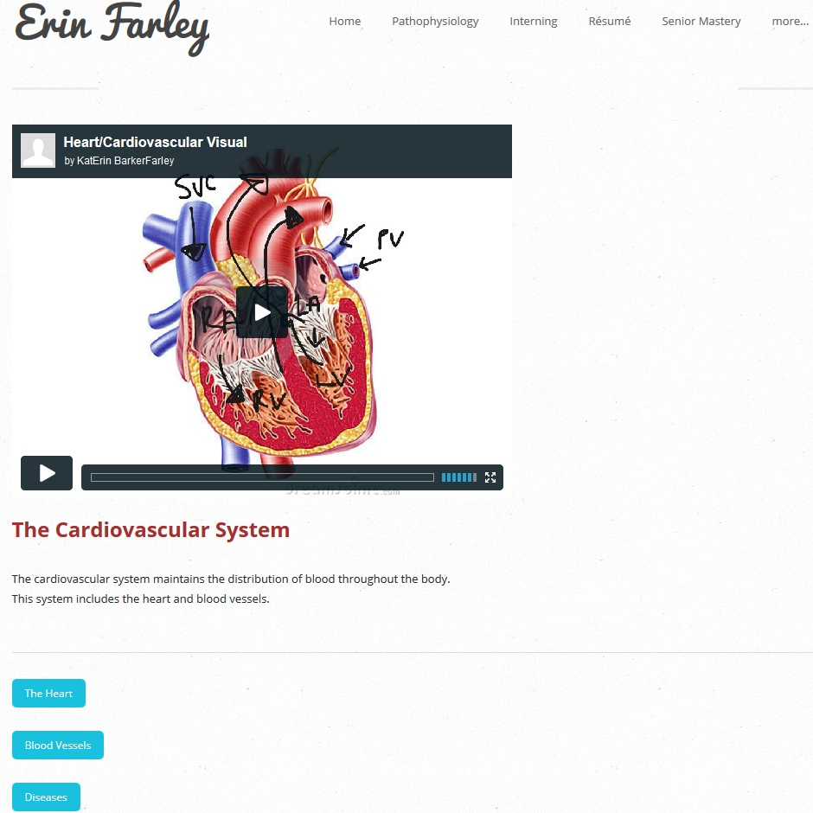
Pathophysiology Notebook
efarl44.weebly.com/cardiovascular.html

Slide 10
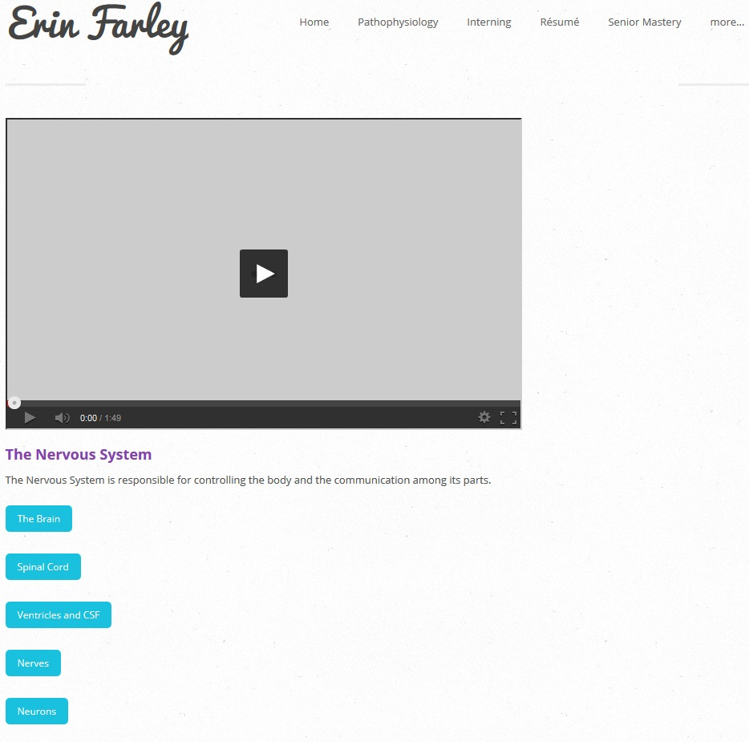
Pathophysiology Notebook
efarl44.weebly.com/nervous.html

Slide 11
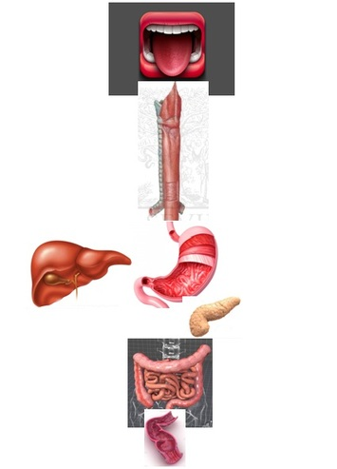
Pathophysiology Notebook
Cirrhosis Prezi
efarl44.weebly.com/cirrhosis.html

Slide 12
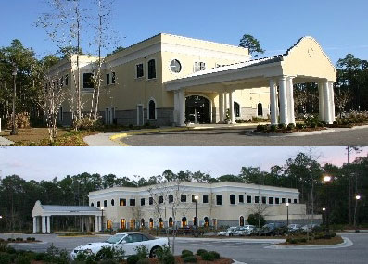
Interning
Grande Dunes Surgery Center

Slide 13
Interning

Slide 14
Senior Project
TXT L8R program with HTC and Officer Barnes
http://www.zazzle.com/txtl8r_put_your_phone_down_vintage_girl_telephone_yardsign-256532876816809487

Slide 15
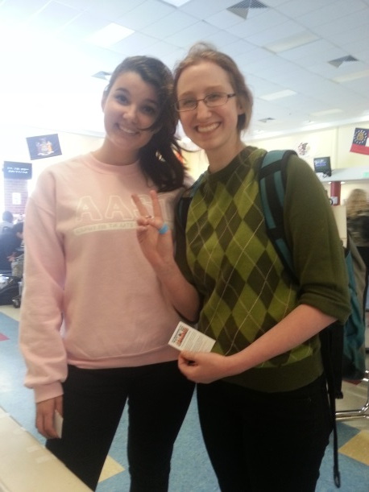
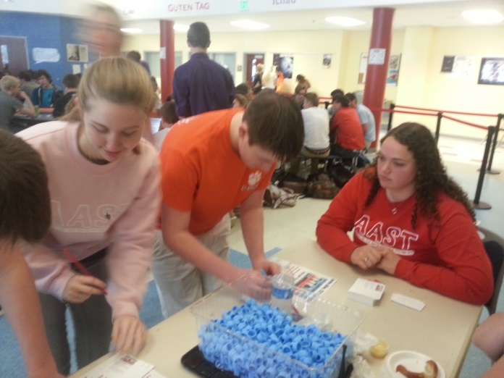
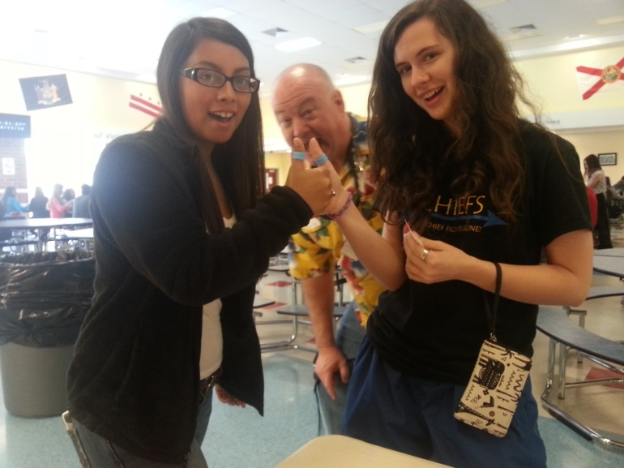
TXT L8R

Slide 16
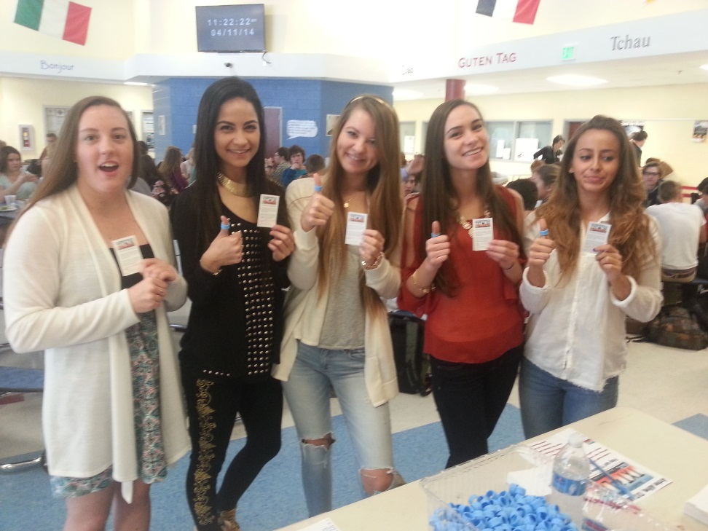
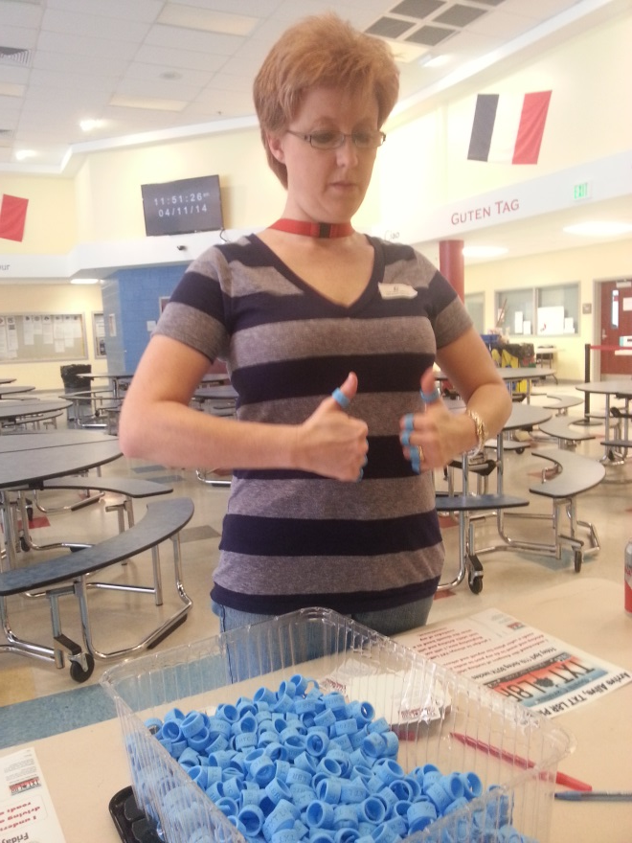
TXT L8R

Slide 17
Research

Slide 18
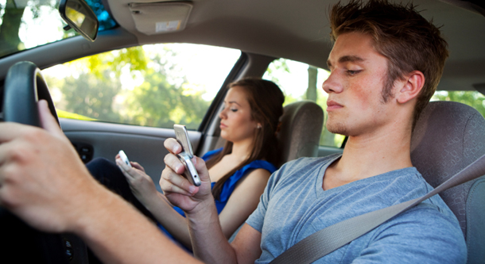
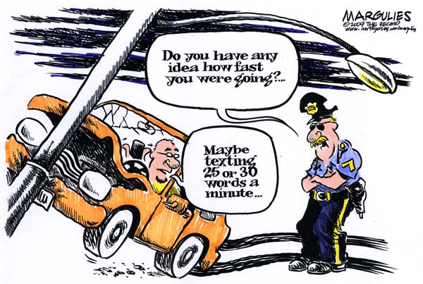
Research
http://newsroom.aaa.com/wp-content/uploads/2010/05/TextingandDriving.jpg
http://2.bp.blogspot.com/_lm2JI7sGwYI/Sm0x_T_hSmI/AAAAAAAAGDE/BqjWkkYhCKA/s1600-h/cel+phone+driving.jpg

Slide 19
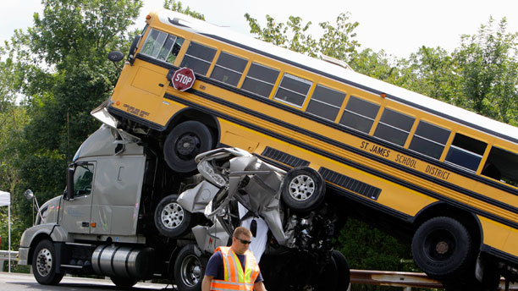
Research
http://autos.aol.com/article/texting-teenager-responsible-for-deadly-highway-pile-up/

Slide 20
THANK YOU

